Slide 1


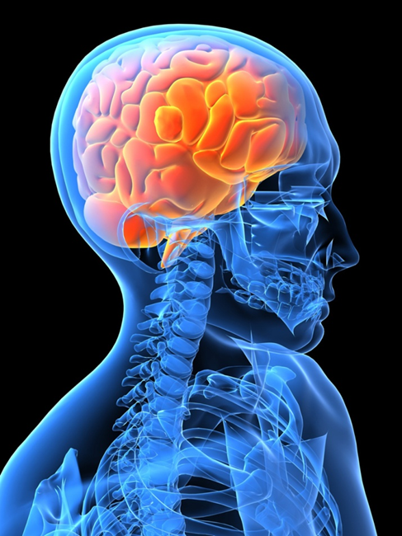
Brain Tumor Detection Using Image Segmentation
BANGALORE INSTITUTE OF TECHNOLOGY
PRESENTED BY:
Yuvraj Singh (1BI19EC170)
Shubham Kumar (1BI19EC138)
Ankush (1BI18EC015)
GUIDED BY:
Dr. A M Vijaya Prakash
Professor, Dept. of Electronics & Communication

Slide 2
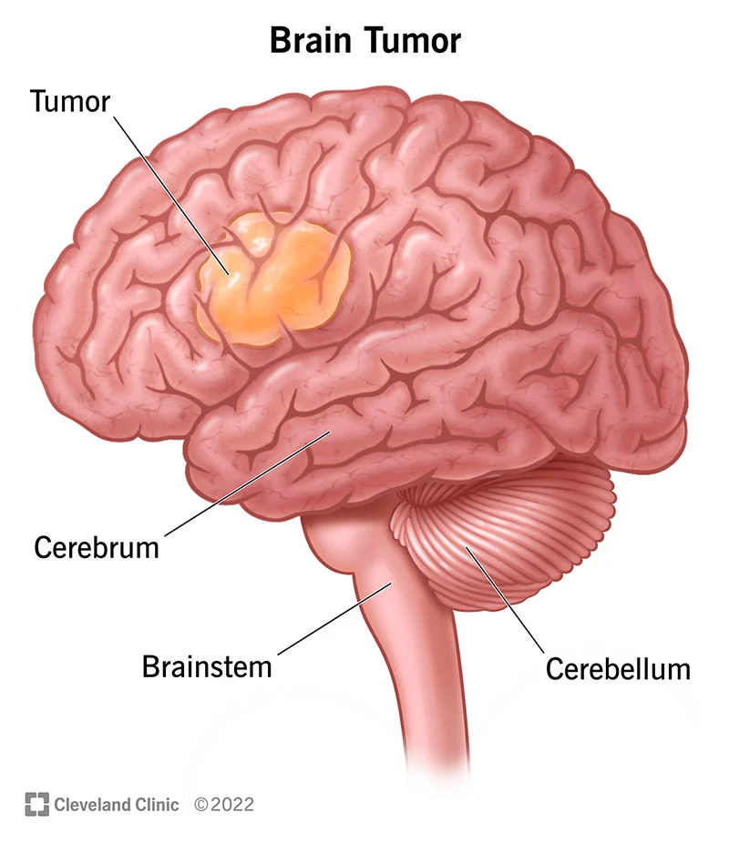
What is a Brain Tumor ?
A collection of abnormal cells that grows in the brain or central Spine canal, One abnormal cell becomes two, two becomes four, four becomes eight,until there is a lump of abnormal cells.
There are 2 types of Brain Tumor -
Primary Brain Tumor
Secondary Brain Tumor

Slide 3
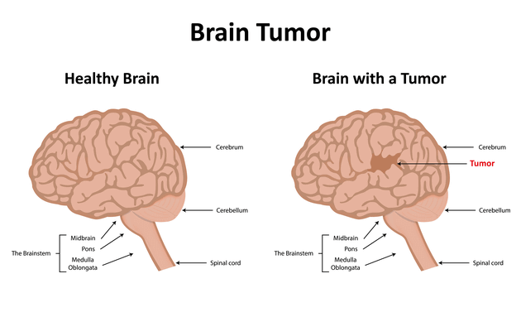

Slide 4
Primary Brain Tumors:
﻿﻿These tumors can be Benign or Malignant. Primary tumors originates in the CNS
﻿﻿Benign brain tumors do not contain cancer cells :
﻿﻿Usually, benign tumors can be removed and the rarely grow back. Benign brain tumors have an obvious border or edge.
﻿﻿They don't spread to other parts of the body They don't invade tissues around them However, benign tumors can press on sensitive area of brain and can cause serious health problems.
Unlike benign tumor of other parts of the body, benign tumor of the brain are sometimes life threatening. with time benign brain tumors can become malignant.

Slide 5
Malignant brain tumors (Also called Brain Cancer) contain cancer cells:
﻿﻿More serious and often are threat to life
﻿﻿Rapid Growth
﻿﻿Invade or crowd nearby healthy brain tissue Cancer cell may spread to other parts of the brain or to the spinal cord
﻿﻿rarely spread to other parts of the body.

Slide 6
Secondary brain tumors also called as Metastatic Brain Tumor originates from malignancies outside of the CNS and spread to the brain, typically through arterial circulation.
﻿Approx. 25% of individual with systemic cancer develop metastatic brain tumor approx. 80% in cerebral hemisphere and 20% in the posterior fossa.
﻿1/3rd of bin metastases orginate in lungs and followed in manner below in order of frequency : Lungs->Breast-›Skin-›GI tract-›Kidney
﻿Frontal lobe is the most common site
﻿Average survival with the treatment is approx. 6 months but varies widely by the extent of other systemic metastases.

Slide 7
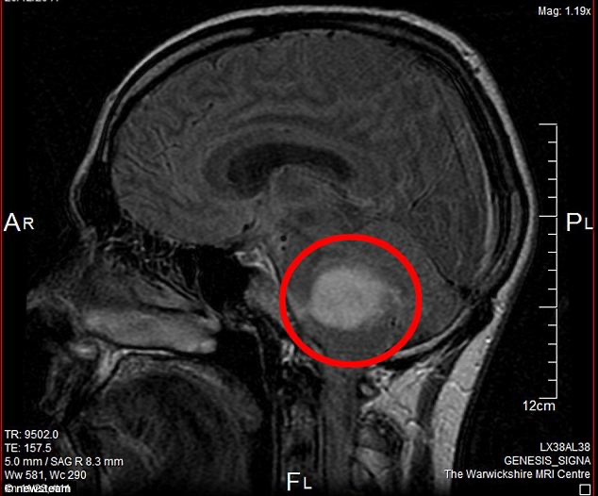
ABSTRACT
Brain tumor at early stage is very difficult task for doctors to identify. MRI images are more prone to noise and other environmental interference. So it becomes difficult for doctors to identify tumor and their causes.
So here we come up with the system, where system will detect brain tumor from images. System will process the image by applying image processing steps.

Slide 8
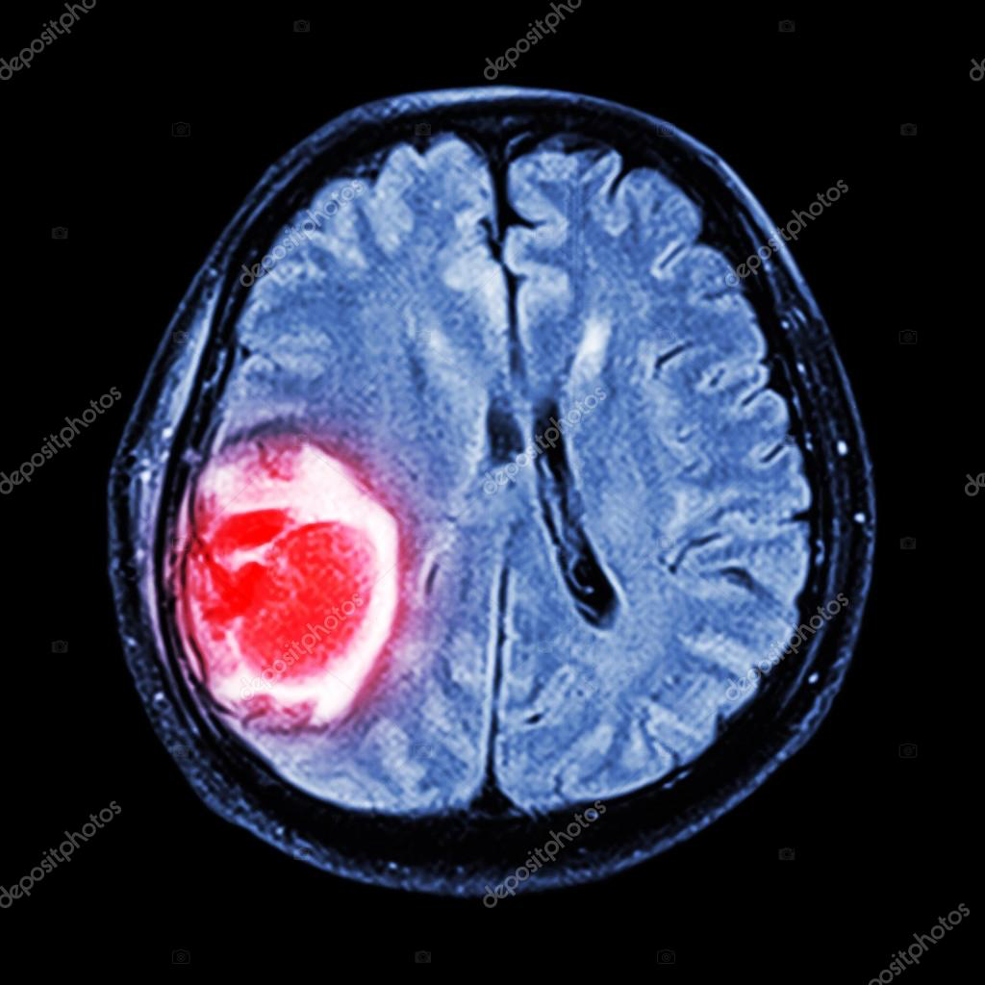
We applied a unique algorithm to detect tumor from brain image .But edges of the image are not sharp in early stage of brain tumor. So we apply image segmentation on image to detect edges of the images.
Brain tumor can be denoted as a malformed mass of tissue wherein the cells multiply abruptly and ceaselessly, that is there is no control over the growth of the cells. The process of Image segmentation is adopted for extracting abnormal tumor
region within the brain. In the MRI (magnetic resonance
image), segmentation of brain tissue holds very significant in order to identify the presence of outlines concerning the brain tumor.

Slide 9
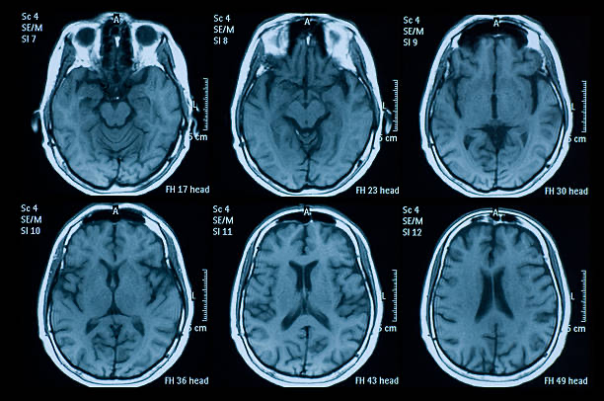
MRI SCAN OF HUMAN BRAIN

Slide 10
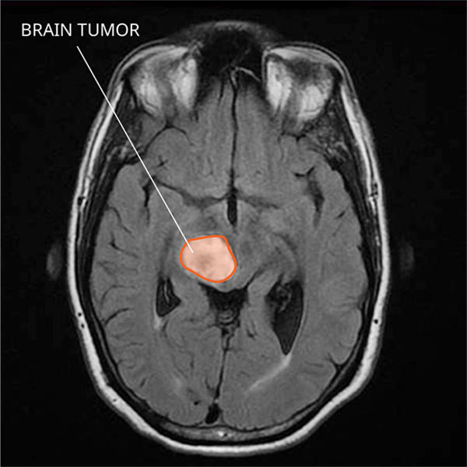
IMAGE DEPICTING BRAIN TUMOR

Slide 11
Introduction
Deep learning (subfield of machine learning) has gained prominence in almost every field where decision-making is involved in recent years, spanning economics, health care, marketing, and sales.
In this machine learning project, we build a classifier to detect the brain tumor (if any) from the MRI scan images. By now it is evident that this is a binary classification problem. Examples of such binary classification problems are Spam or Not spam, Credit card fraud (Fraud or Not fraud).

Slide 12







Tools To Be Used
Brain tumor detection project uses the below libraries and frameworks (Tentative):
Python
TensorFlow
Keras
Numpy
Scikit-learn
Matplotlib
OpenCV

Slide 13
Our approach to building the classifier is discussed in the steps:
Perform Exploratory Data Analysis (EDA) on brain tumor dataset
Build a CNN model
Train and Evaluate our model on the dataset
We will be using MRI scans dataset front the following website for extracting images for our model.
https://www.kaggle.com/datasets/navoneel/brain-mri-images-for-brain-tumor-detection

Slide 14
METHODOLOGY
The research proposes an automatic segmentation method that relies upon
CNN (Convolution Neural Networks), determining small 3 x 3
kernels. By incorporating this single technique, segmentation
and classification is accomplished. CNN (a ML technique)
from NN (Neural Networks) wherein it has layer based for
results classification.

Slide 15
Various levels involved in the proposed mechanisms are:
1. Data collection
2. Pre-processing
3. Average filtering
4. Segmentation
5. feature extraction
6. CNN via classification and identification.
The techniques of ML (machine learning) are being effectively employed for brain tumor detection and prevention at an early stage.

Slide 16
EXPECTED OUTCOME
The predictions made by the model will be an array with each value being the probability that it predicts the image belongs to that category. So, we take the maximum of all such probabilities and assign the predicted label to that image input.
A confusion matrix is a matrix representation showing how well the trained model predicts each target class with respect to the counts. It contains 4 values in the following format:
[ TP FN ]
[ FP TN ]

Slide 17
True positive (TP): Target is positive and the model predicted it as positive
False negative (FN): Target is positive and the model predicted it as negative
False positive (FP): Target is negative and the model predicted it as positive
True negative (TN): Target is negative and the model predicted it as negative
The classification report provides a summary of the metrics precision, recall and F1-score for each class/label in the dataset. It also provides the accuracy and how many dataset samples of each label it categorized.
Accuracy of the model can be calculated with the formula
= (TP + TN) / (TP + FN + FN + TN)

Slide 18
REFERENCES
Brain Tumor Detection Using Deep Learning Models
https://ieeexplore.ieee.org/document/9344555

